Slide 1

Scheduling
(Chapter 7 & 8)
Prepared by:
Azizur Rahman Anik
Lecturer, department of CSE, UIU

Slide 2

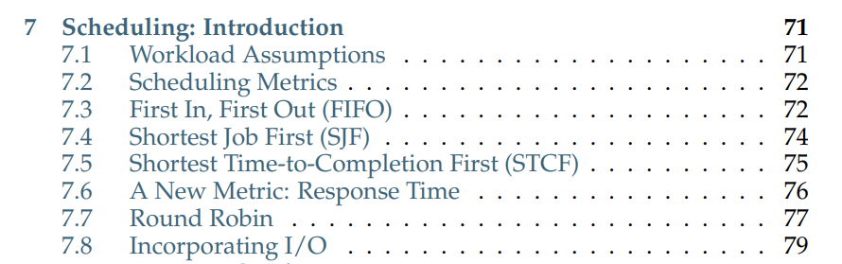
Chapter 7- Scheduling: Introduction

Slide 3
THE CRUX: HOW TO DEVELOP SCHEDULING POLICY
How should we develop a basic framework for thinking about scheduling policies?
What are the key assumptions?
What metrics are important?
What basic approaches have been used in the earliest of computer systems?

Slide 4
Scheduling: Workload Assumptions
We will make the following assumptions about the processes, sometimes called jobs, that are running in the system:
  1. Each job runs for the same amount of time.
  2. All jobs arrive at the same time.
  3. Once started, each job runs to completion.
  4. All jobs only use the CPU (i.e., they perform no I/O)
  5. The run-time of each job is known.
Note: The workload assumptions we make here are mostly unrealistic, but that is alright (for now), because we will relax them as we go, and eventually develop what we will refer to as a fully-operational scheduling discipline.

Slide 5
Scheduling: Scheduling Metrics
To enable us to compare different scheduling policies, we need a scheduling metric.
Turnaround Time(Performance metric): The time at which the job completes minus the time at which the job arrived at the system.
Tturnaround = Tcompletion − Tarrival
Fairness
Performance and fairness are often at odds.

Slide 6
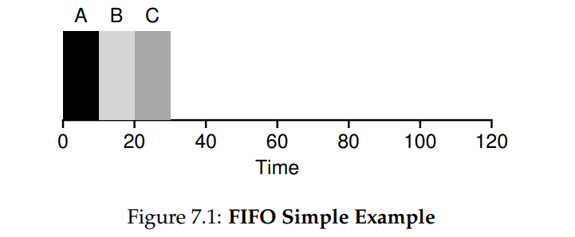
Scheduling: First In, First Out (FIFO)
First In, First Out(FIFO) or First Come, First Served (FCFS)
The job that comes first is scheduled first until completion.
In the following example, A,B,C jobs come almost at the same time.
the average turnaround time for the three jobs is simply (10+20+30) / 3 = 20
Tturnaround = Tcompletion − Tarrival

Slide 7
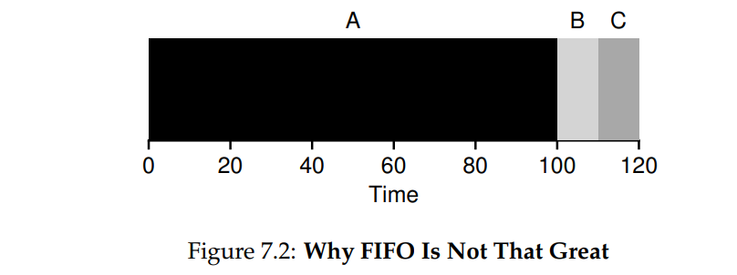
Scheduling: First In, First Out (FIFO)
  Now let’s relax assumption 1: Each job runs for the same amount of time.
  No longer assume that each job runs for the same amount of time.
  How does FIFO perform now? What kind of workload could you construct to make FIFO perform poorly?
the average turnaround time for the three jobs is simply (100+110+120) / 3 = 110
Tturnaround = Tcompletion − Tarrival

Slide 8
Scheduling: First In, First Out (FIFO)
  Convoy Effect: A number of relatively short potential consumers of a resource get queued behind a heavy-weight resource consumer.
  How can we develop a better algorithm to deal with our new reality of jobs that run for different amounts of time?
the average turnaround time for the three jobs is simply (100+110+120) / 3 = 110
Tturnaround = Tcompletion − Tarrival

Slide 9
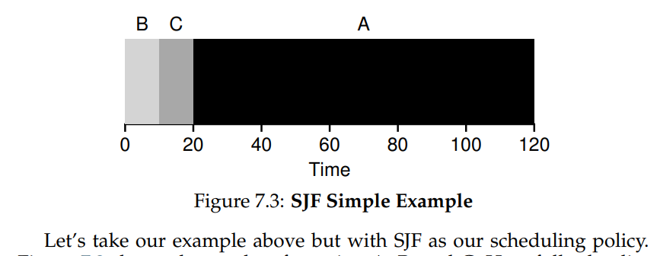
Scheduling: Shortest Job First (SJF)
  It runs the shortest job first, then the next shortest, and so on
the average turnaround time for the three jobs is simply (10+20+120) / 3 = 50
Tturnaround = Tcompletion − Tarrival

Slide 10
Scheduling: Shortest Job First (SJF)
  Given our assumptions about jobs all arriving at the same time, we could prove that SJF is indeed an optimal scheduling algorithm.
  However, you are in a systems class, not theory or operations research; no proofs are allowed.
  Let’s relax our assumption 2: All jobs arrive at the same time.
  Now assume that jobs can arrive at any time instead of all at once.

Slide 11
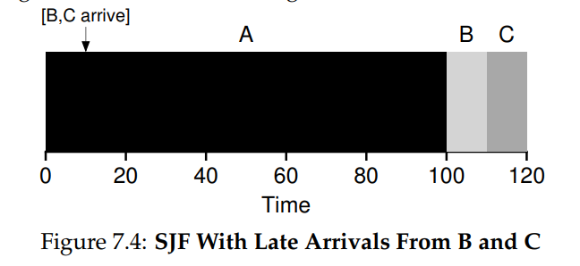
Scheduling: Shortest Job First (SJF)
  Assume job A arrives at t=0 and needs to run for 100 seconds.
  B and C arrive at t=10 and each need to run for 10 seconds.
even though B and C arrived shortly after A, they still are forced to wait until A has completed, and thus suffer the same convoy problem.
Average turnaround time for these three jobs is 103.33 seconds (( 100+(110−10)+(120−10))/ 3 ).
What can a scheduler do?

Slide 12
Scheduling: Shortest Time-to-Completion First (STCF)
  To address this concern, we need to relax assumption 3: Once started, each job runs to completion.
  We can interrupt a job while it is executing – known as preemption.
  The scheduler should be able to preempt a job, and decide to run another job.
  Any time a new job enters the system, the STCF scheduler determines which of the remaining jobs (including the new job) has the least time left, and schedules that one.

Slide 13
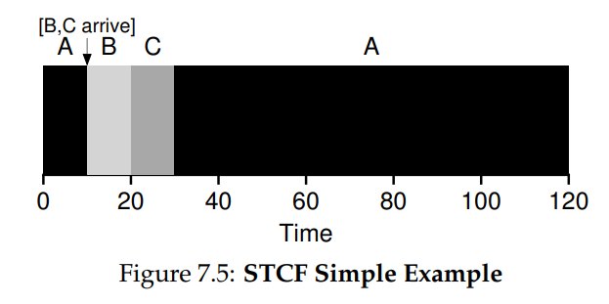
Scheduling: Shortest Time-to-Completion First (STCF)
Continuing the previous example…
  Assume job A arrives at t=0 and needs to run for 100 seconds.
  B and C arrive at t=10 and each need to run for 10 seconds.
The result is a much-improved average turnaround time: 50 seconds (( (120−0)+(20−10)+(30−10))/3 ).

Slide 14
Scheduling: A New Metric – Response Time
A New Scheduling – Round Robin
Response time is required for interactive performance.
We define response time as the time from when the job arrives in a system to the first time it is scheduled.
More formally: T_response = T_first_run − T_arrival
A new scheduling algorithm that takes care of response time – Round Robin
Instead of running jobs to completion, RR runs a job for a time slice (sometimes called a scheduling quantum) and then switches to the next job in the run queue.
It repeatedly does so until the jobs are finished

Slide 15
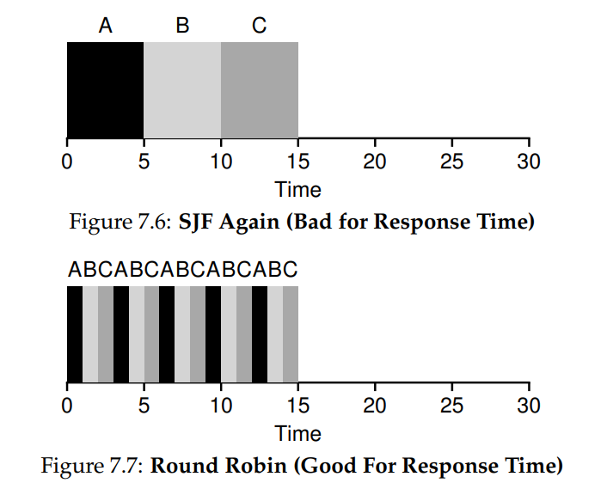
Scheduling: Round Robin (RR)
RR with a time-slice of 1 second would cycle through the jobs quickly (Figure 7.7).
The average response time of RR is: (0+1+2)/ 3 = 1
For SJF, average response time is: (0+5+10)/ 3 = 5

Slide 16
Scheduling: Round Robin
RR is sometimes called time-slicing.
Note that the length of a time slice must be a multiple of the timer-interrupt period
Thus if the timer interrupts every 10 milliseconds, the time slice could be 10, 20, or any other multiple of 10 ms.

Slide 17
Scheduling: Round Robin
The shorter it is, the better the performance of RR under the response-time metric.
However, making the time slice too short is problematic: suddenly the cost of context switching will dominate overall performance.
Thus, deciding on the length of the time slice presents a trade-off to a system designer, making it long enough to amortize the cost of switching without making it so long that the system is no longer responsive.

Slide 18
Scheduling: Incorporating I/O
First, we relax assumption 4: All jobs only use the CPU (i.e., they perform no I/O)
A job doesn’t use the CPU during the I/O operation
Therefore, the scheduler should schedule another job on the CPU at that time.
When I/O request is initiated, the process goes to Blocked state from the Running state.
When the I/O is completed, an interrupt is raised. Then the OS moves that process from Blocked State to Ready State.

Slide 19
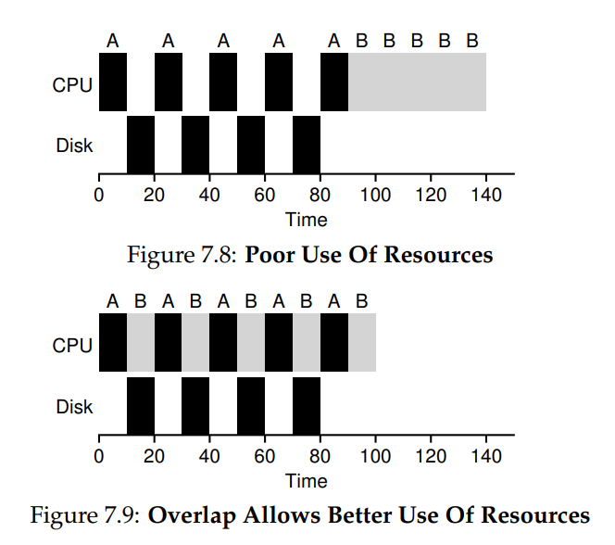
Scheduling: How to deal a job that performs I/O?
Treat each sub-job as an independent job.
In the figure, each sub-job of job A takes 10 ms time. They are considered as independent jobs in the 2nd figure.
Doing so allows for overlap, with the CPU being used by one process while waiting for the I/O of another process to complete; the system is thus better utilized

